Slide 1
Case studies –
African masking traditions
Life Cycle Events
Initiation: Adolescence into Adulthood &
Funeral Rites for the Deceased

Slide 2
Ceremonies
Ceremonies are often created in combination of oral lore or myths that are part of the cultural tradition of the particular social or ethnic group.
Ceremonies are meant to provide a profound sensory experience through dramatic presentations.
Therefore these events are very dramatic, there are various symbols and symbolic actions that are related to myths and beliefs

Slide 3
Guides for the life transitions
Who …by their words, deeds, or presence has helped you confront the challenges of living an adult life?
With a partner discuss one example that you would say was one of the most challenging things you have had to work through as an adult.
Include any information on how you got through that.

Slide 4
What are typical life challenges as an adult?
What kind of factors serve as guides for those challenges?
Typical challenges
Guides for challenges

Slide 5
The cycle of life and transitions are common events for masking traditions
Maturation – initiation rites that symbolically mark the transition from adolescence to adulthood
Marriage
A time when a person enters into a higher rank in society
Death - Transformation from life on earth to becoming an ancestor
death

Slide 6
The idea of transition
Gateways
Battles
Endings and beginnings
Death and rebirth …boys/girls must die to be reborn etc
Sometimes there are elders who instruct from masks
Sometimes masks represent symbolic monsters guarding the passages from one stage to another, testing the young initiates for their readiness for being an adult.

Slide 7
The role of Myths or Oral histories in Masking Arts
Myths that orally delivered in performances by story tellers or Griots (historians chanting myths or stories) might provide rich descriptive, powerful explanations about…
The origin of the world or how it was created
The history of the tribe (ethnic group); important successes or migrations
What happens to people when they die
Important ancestors or heroes
proper behavior
Other themes such as farming,
dilemmas in life, etc.
ALL of these kinds of things can be acted out in their ceremonies as little plays or key ideas might be symbolically referenced on the masks itself

Slide 8
The role of the ancestor during initiation rites
“During initiation ceremonies, the masks worn, depict an ancestor. The purpose would be to gain favor and to be received into the tribe as a vital member.”
From
https://oloolutof.wordpress.com/2012/09/16/yoruba-masks-the-importance/

Slide 9
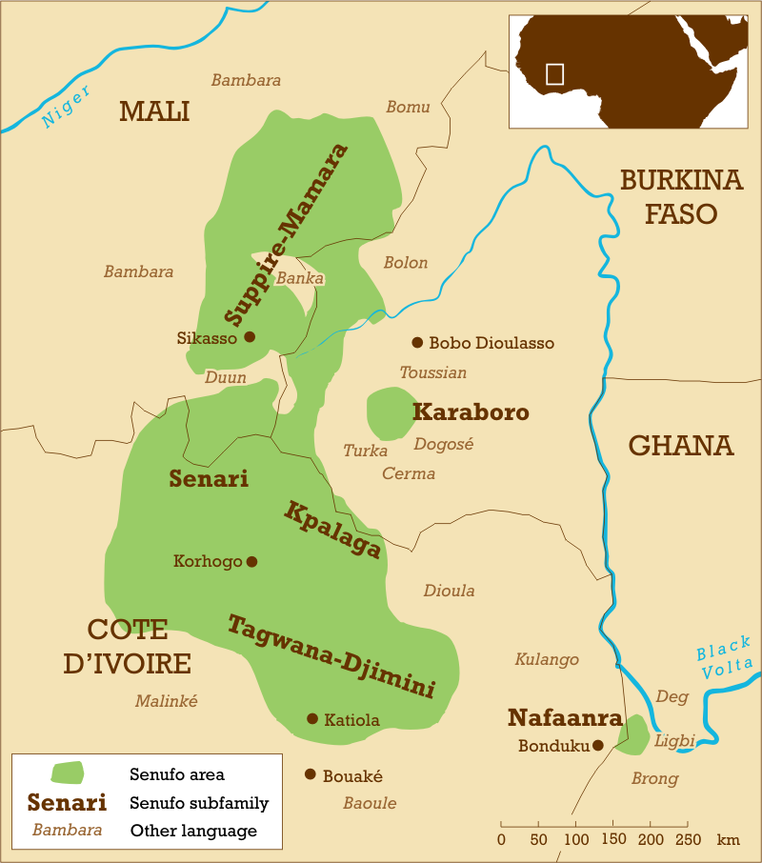
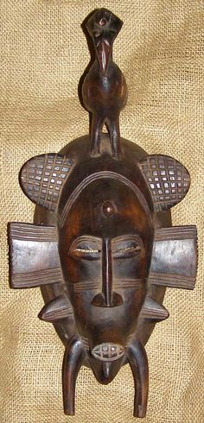
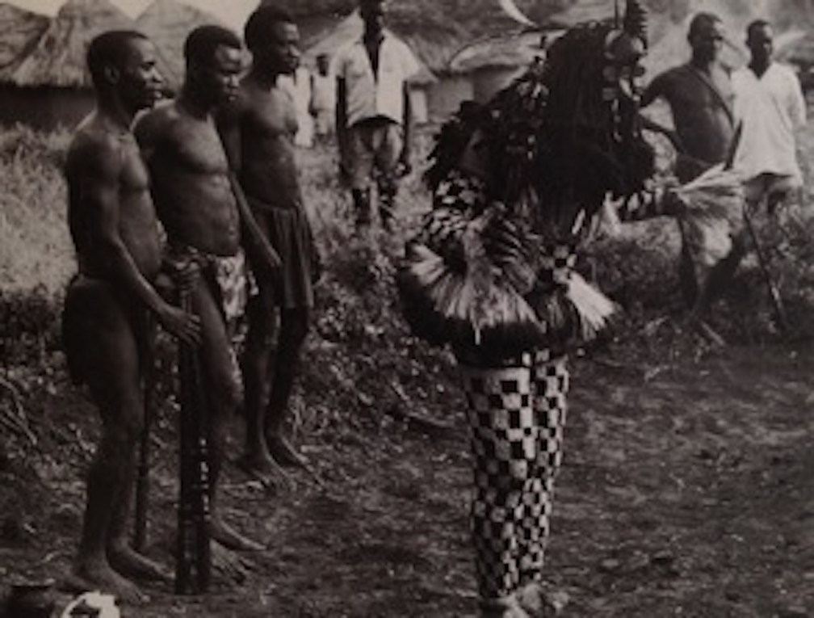
CASE STUDY #1 Initiation Rites and Masking
The Senufo
Senufo and ethnic group of northern Cote d’ Ivoire
(Ivory Coast), Mali and Burkina Faso
Notes:
Kpellie Dancer source: Herzog, "African Masks"

Slide 10
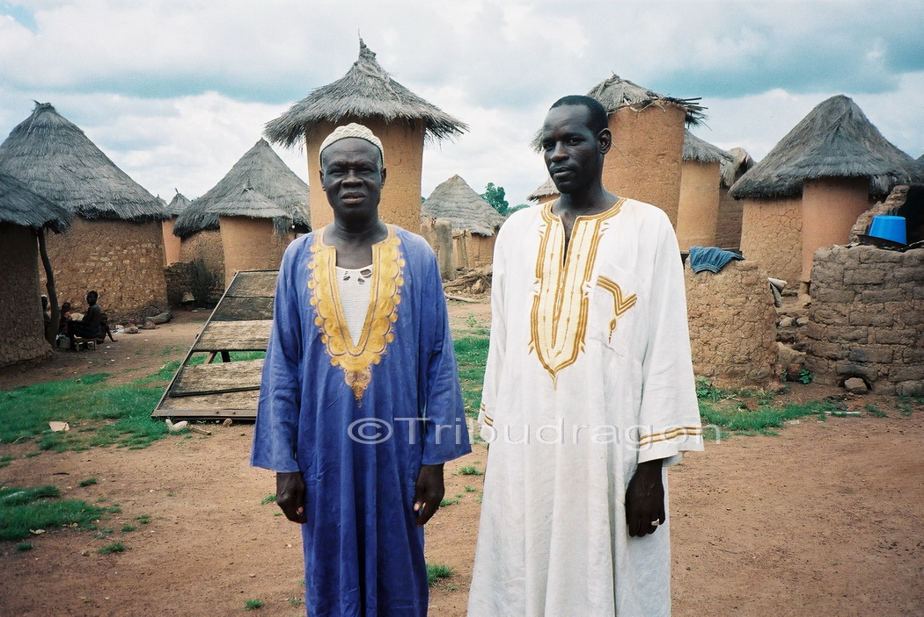
The Senufo
The Senufo people are predominantly animists but a few practice Islam.
The Senufo come from a lineage of farming and hunting traditions, and they have all kinds of poro, or religious societies, sometimes organized around occupations such as carvers, blacksmiths, bronze casters etc.
Women occupy the highest leadership roles in this ethnic group
They are regionally famous for their handicrafts, many of which feature their cultural themes and religious beliefs.
...
Notes:
https://zoede.com/the-senufo-of-ivory-coast-culture-and-historical-facts/

Slide 11
The poro brotherhood,
The poro brotherhood initiation school is usually located in the forest and serves as a training process for young men until they reach various phases of adulthood.
The education involves preparation and information for both the religious and civic responsibilities they will have to their community, where they might even be developing laws and/or make decisions regarding conflict, etc.
The ceremony for them consists of carrying them into the Poro bush and out again.
The purpose of their initiation is to deter antisocial behavior or beliefs in the development of males in the society.
Notes:
https://zoede.com/the-senufo-of-ivory-coast-culture-and-historical-facts/

Slide 12
Initiation rites with the Poro brotherhood Senufo
The Poro brotherhood – an arm of the poro school, in an ongoing religious institution for men that has an extensive initiatory process for maturation-[takes 21 years]
With initiation practices focused on the character and behavior of community members
The elders might use a mask to align themselves with ancestral powers to provide social control and instruction to those you are younger.
Every 7 years men move up in status in their membership of the Poro brotherhood
At stage 3 [21 years] the members carry out the initiation rites and funeral rites for others.

Slide 13
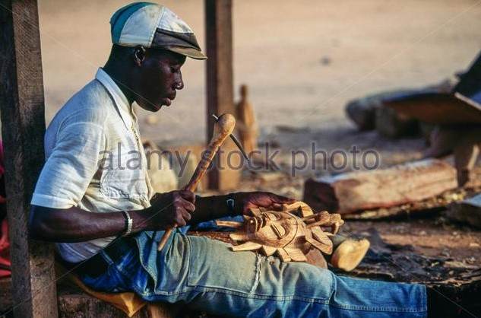
artisans
Much sculptured work is made in the poro brotherhood
this is where much of the wood carvings, brass sculptures, and masks are made.

Slide 14
Poro philosophy in brief
"Beliefs include the conviction that there are deep and hidden things about an individual that only diviners, priests, and other qualified persons can unravel” … therefore “whatever exists or happens in the physical realm has foundations in the spirit world“.

Slide 15
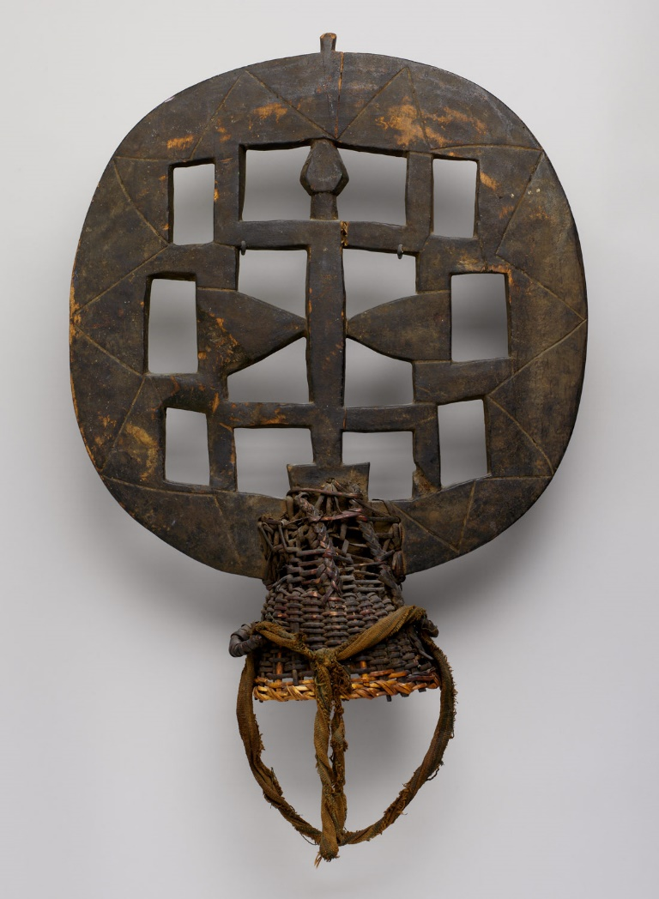
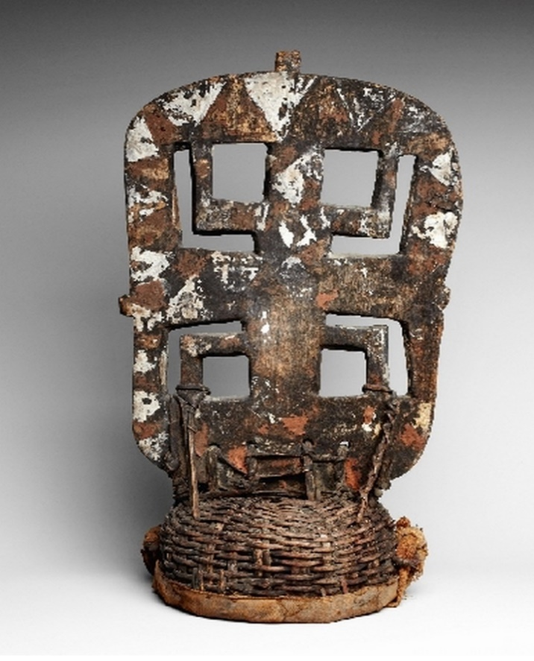
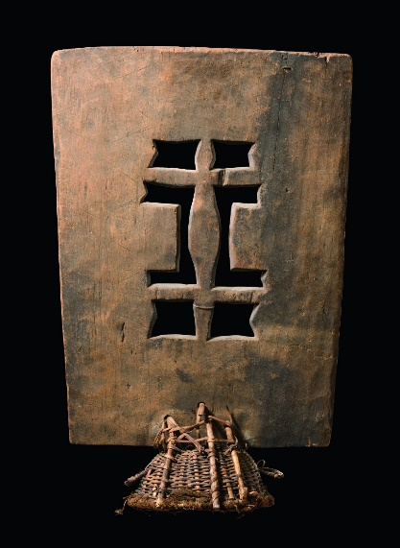
kworo
The evening before their entrance into the sacred grove at the beginning of the intermediate stage of poro,
initiates in some Senufo towns dance in public performances referred to as kworo and used to wear headdress masks like this.
(sits on top of the head)

Slide 16
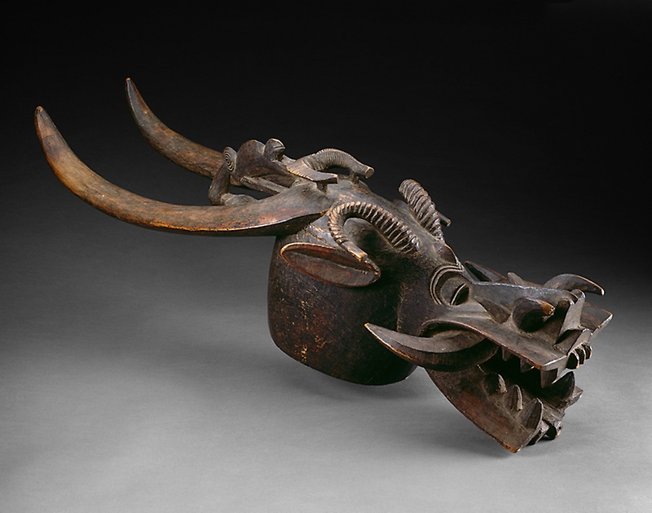
Masks used at funerals are also around to work with the symbolic death of youth during their initiations
Masks like this tend to cause fear and “uncertainty”.
During funerals, it is used to control the soul, to insure it does not leave the body until the body is buried.
It is thought that souls of the deceased can be a problem in the community, if they are allowed to leave and wander about.
kponyugo helmet masks

Slide 17
Kafibele Senufo mask called yarajo
the group of young men have the opportunity to show what they have learned since they began their seven-year novitiate in the Poro grove, for it is primarily they who carry out the ritual acts.
The performance of the Kafibele Senufo mask called yarajo, which appears in public on these occasions, requires a high degree of skill and, therefore, extensive practice.

Slide 18
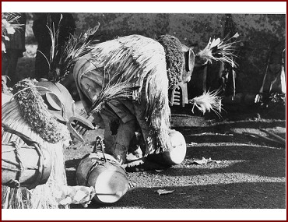
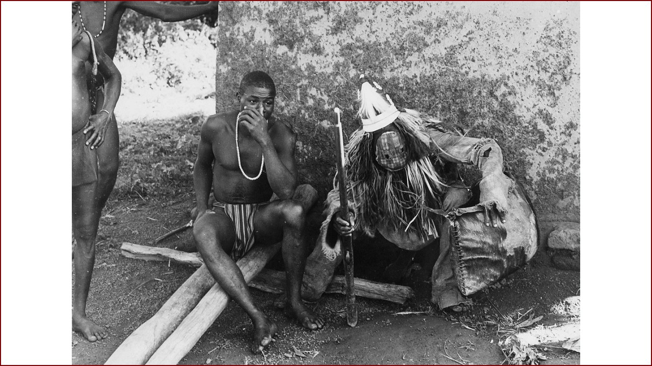
Yarajo mask
When the men return to the village they might wear the yarajo
Notes:
http://liberia.flemister.info/poro.html / http://collectie.wereldculturen.nl/default.aspx?ccid=288289&lang=en

Slide 19
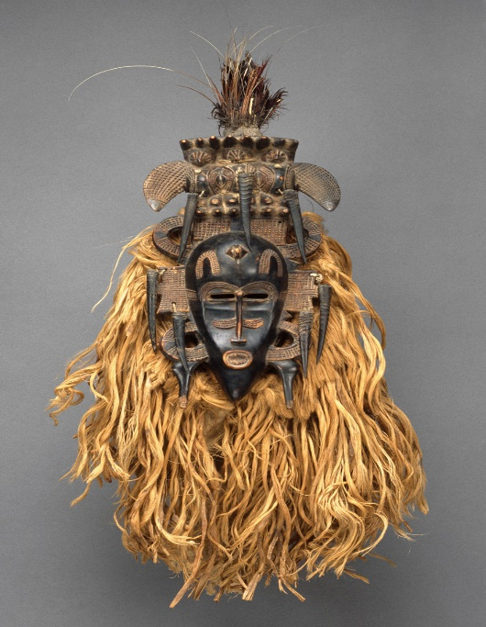
Kpeliye’e – face mask
“Considered feminine, the masks honor deceased Senufo elders with their grace and beauty. They provide a complement to the aggressive Senufo helmet masks also sponsored by fraternal organizations in the region.”
There are a variety of Kpleliye’e masks within the Senufo people One style of masks referred to as “beautiful lady mask” or kpellie or kpeliye
Their dance incorporates womens’ gestures, and uses whisks to honor people.
Raised and incised scarification patterns ornament their smooth, glossy surfaces.
Notes:
https://www.metmuseum.org/toah/works-of-art/1978.412.489/

Slide 20
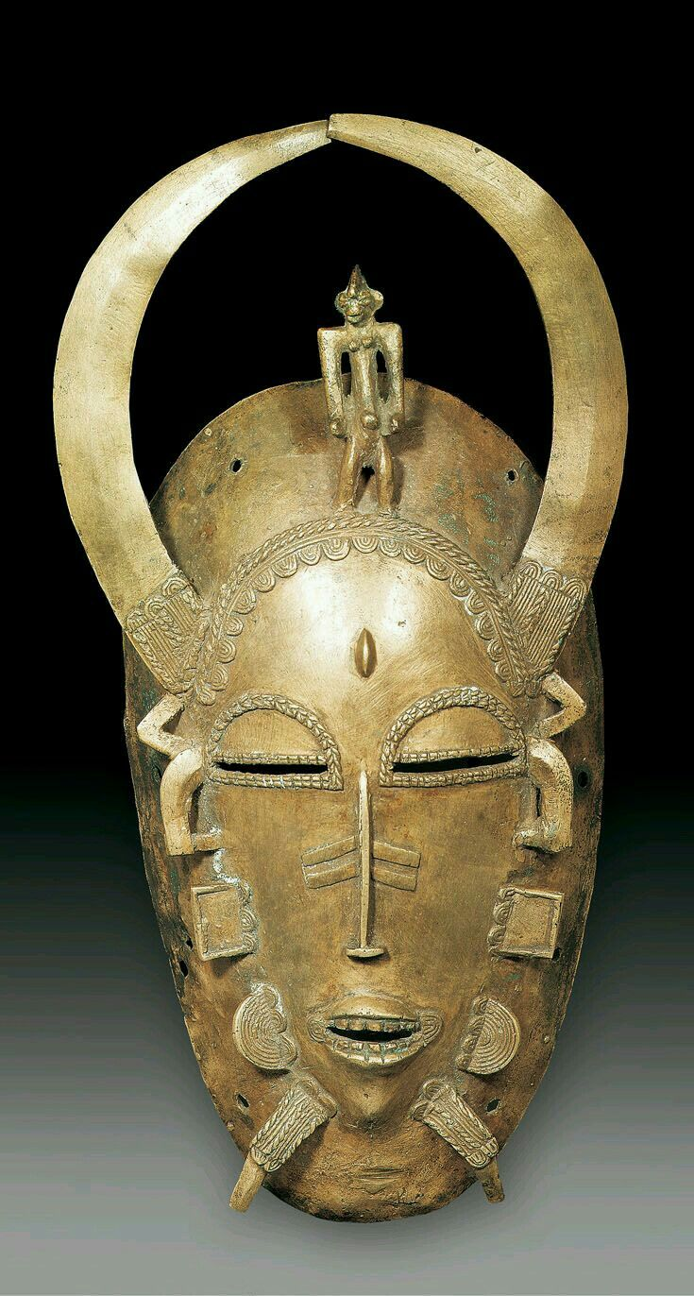
Recognizable features
There are a variety of masks within the Senufo people
These masks are a composite in imagery and meaning, many symbolic elements are either carved in wood or cast in bronze
smallish face masks,, hybrid imagery (human face/animals) as well as within geometric extensions
often have two elongated parts
on the bottom of the mask that look like
legs, but could be locks of hair or jewelry
Notes:
Image source: Visona, "The History of Art in Africa"

Slide 21
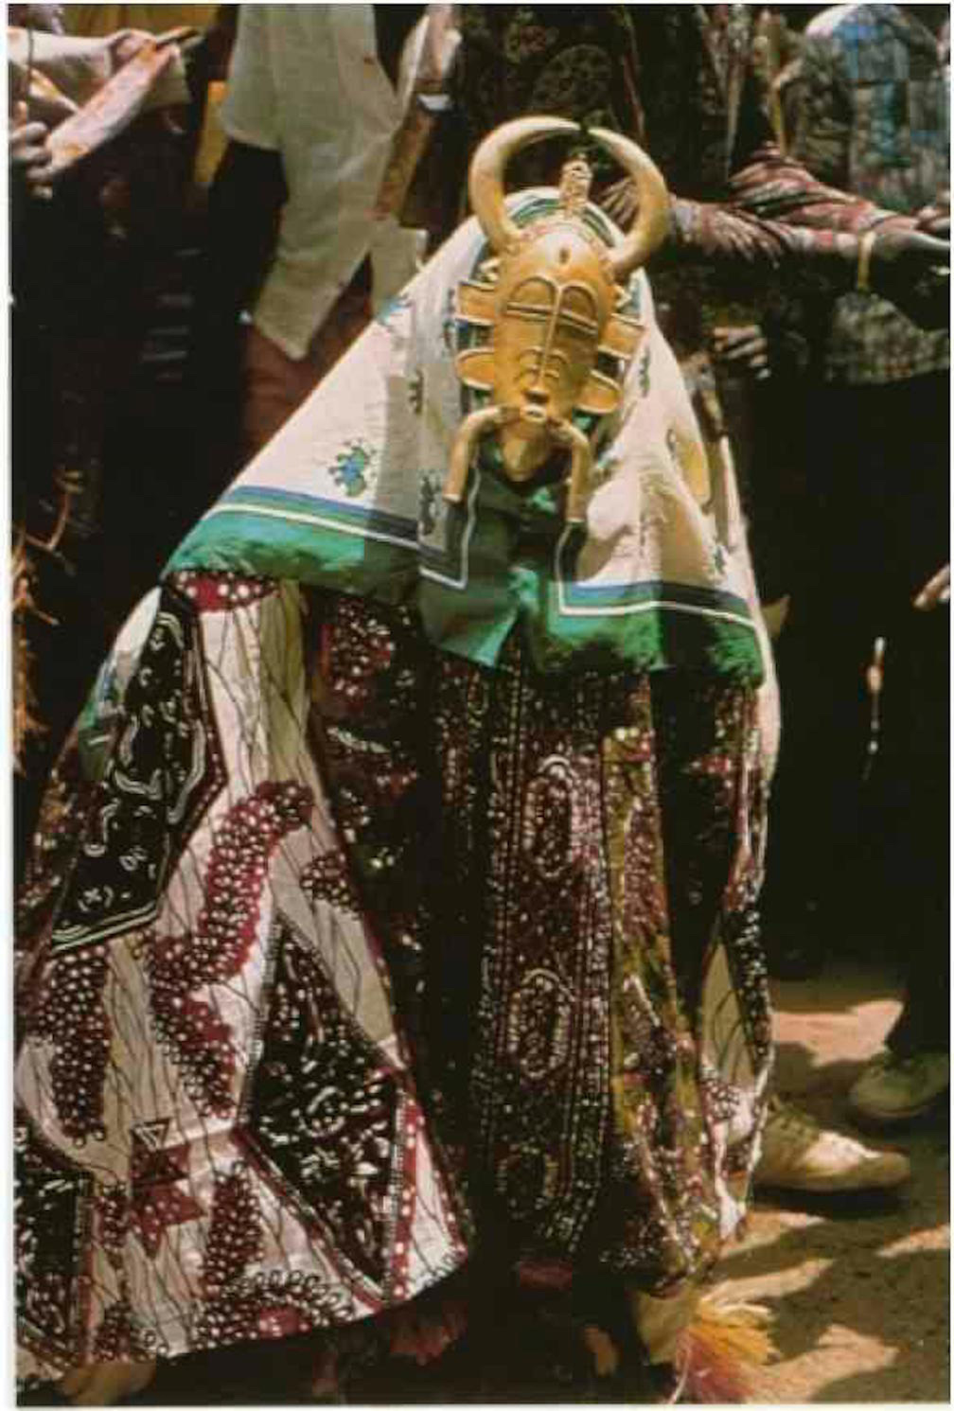
Many masking traditions involve initiation ceremonies
funeral masking are practices by more mature members of their religious associations
Funeral
Mask
honoring a
female elder
in the blacksmith
Poro

Slide 22
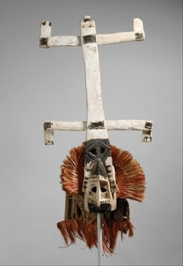
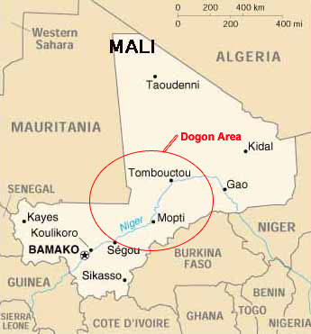
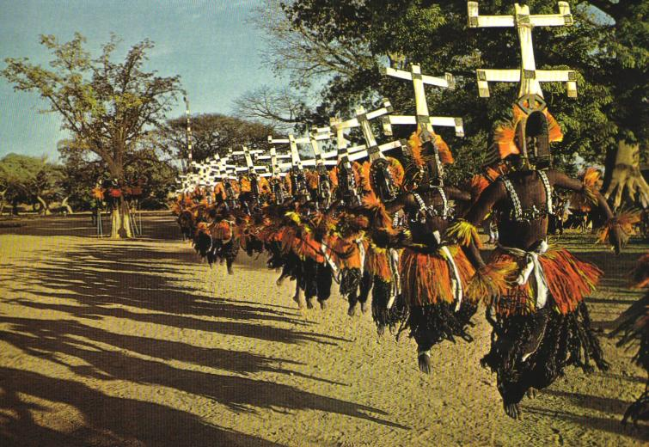
PART 2: Case study on masks and Funeral rites
– The Dogon People
The Dogon people are a tribe in West Africa, mostly in Mali

Slide 23

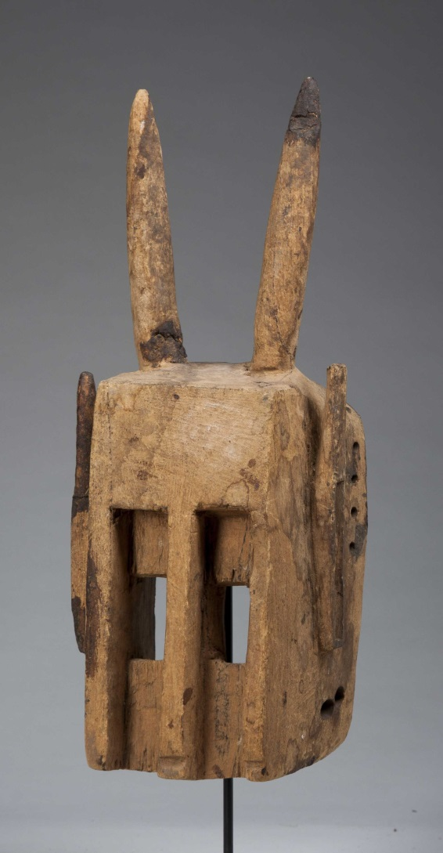
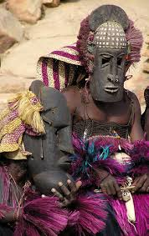
case study:
African masks and Funeral rites
Dogon Masks
there are
a variety of masking traditions
within the Dogon ethnic group
thought to be about 78 different
types of ritual masks among the Dogon
their imaged based, symbolic
messages go beyond the artistic
into the realm of
religion and philosophy.
Many Dogon masks have other Performance elements such as myths and costumes

Slide 24
Funeral rites: case study with the Kanaga mask and the funeral rites of the Dogon
Traditional Funeral rites in Africa often involve masked dances
In Dogon practice there are elaborate funeral masquerades
three stages:
Burial – after the burial the person’s soul is thought to remain in the village
Additional Funeral rites – occur every 6 months for multiple years
And finally the dama - 5 years later is a 6 day rite to help guide the soul into the world of the ancestors and to restore peace to the village.
Awa members are seculed in rock shelters for a period prior to the dart of dama to renew their masks, music and costumes.

Slide 25
Kanaga masks
These masks are typically worn during the dama phase of the funeral rites, and
Some interpretations say they represent the first human beings.
“African Carving: A Dogon Kanaga Mask” from Documentary Educational Resources. 3 mins.
http://www.der.org/films/african-carving.html
Kanaga masks are made of geometric patterns and are normally made by carvers of the Awa society. Have multiple meanings.
Many refer to the double cross design that creates a stylized allusion of a bird, based on a epic story about a hunter
Other interpretations say:
The deeper meaning of the kanaga mask apparently pertains both to God and the creation of the world,
the crossbars being his arms and legs, and to the arrangement of the universe, with the upper crossbar representing the sky and the lower one the earth.

Slide 26
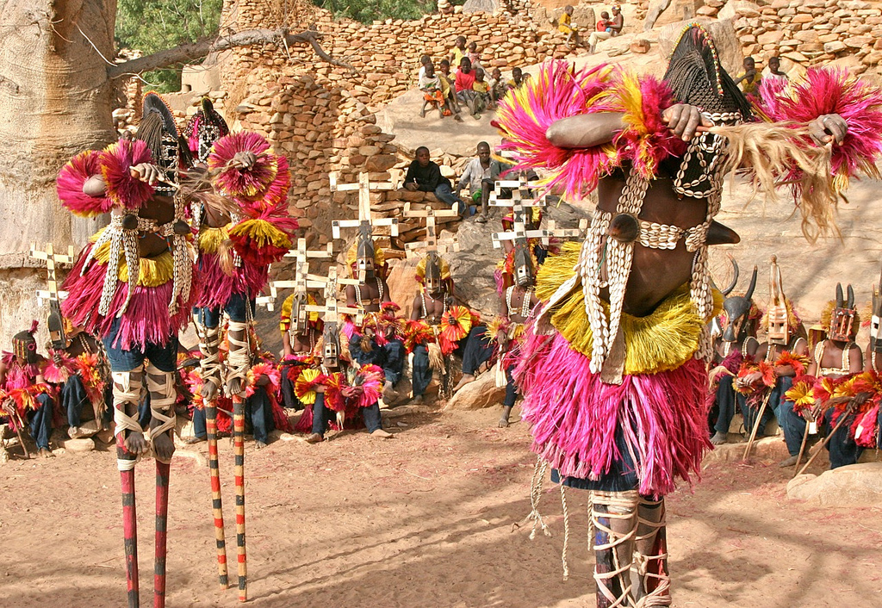
the Dama celebration
During the Dama celebration,
villagers might circle around the stilt dancers.
These stilt performers’ dance and costumes imitate a long-legged water bird. The dancers execute difficult steps while teetering high above the crowd.
Through such rituals, the Dogon believe that the benevolent force of the ancestor is transmitted to them.

Slide 27
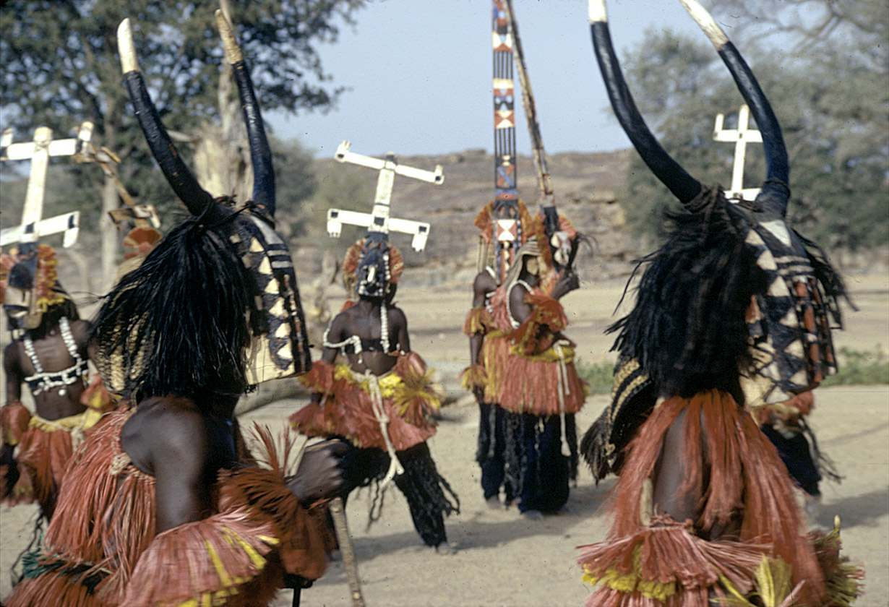
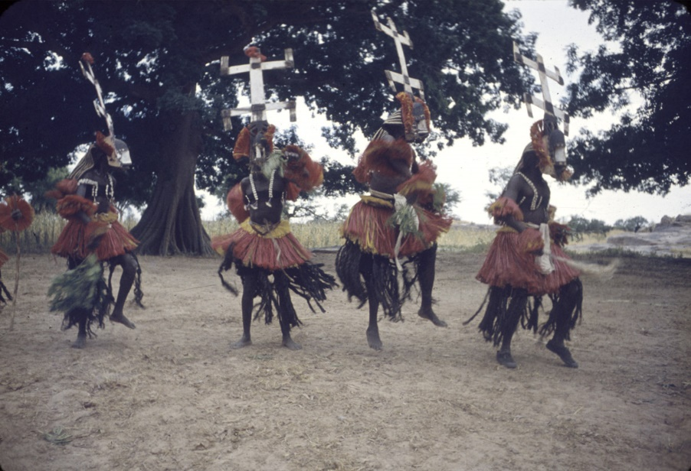
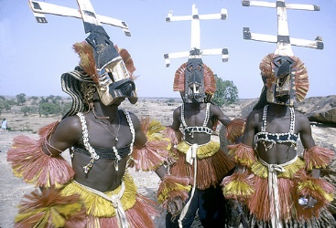
Dramatic mimicry
… or they might parade throughout the village in mock combat in order to drive the soul out of the village

Slide 28
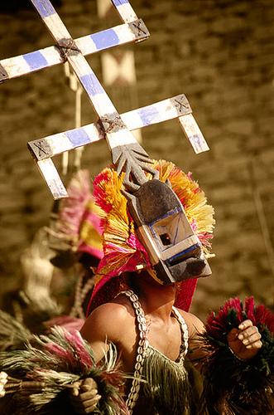
components to the mask
When the mask is worn, the back of the dancer's head is covered with a hood of plaited fiber fringe around the head, at the base of the masks.
The dancer wears a vest made of black strip-woven cloth and red broadcloth strips embroidered with white cowrie-shells;
strands of glass and plastic beads dangle from its edges.

Slide 29
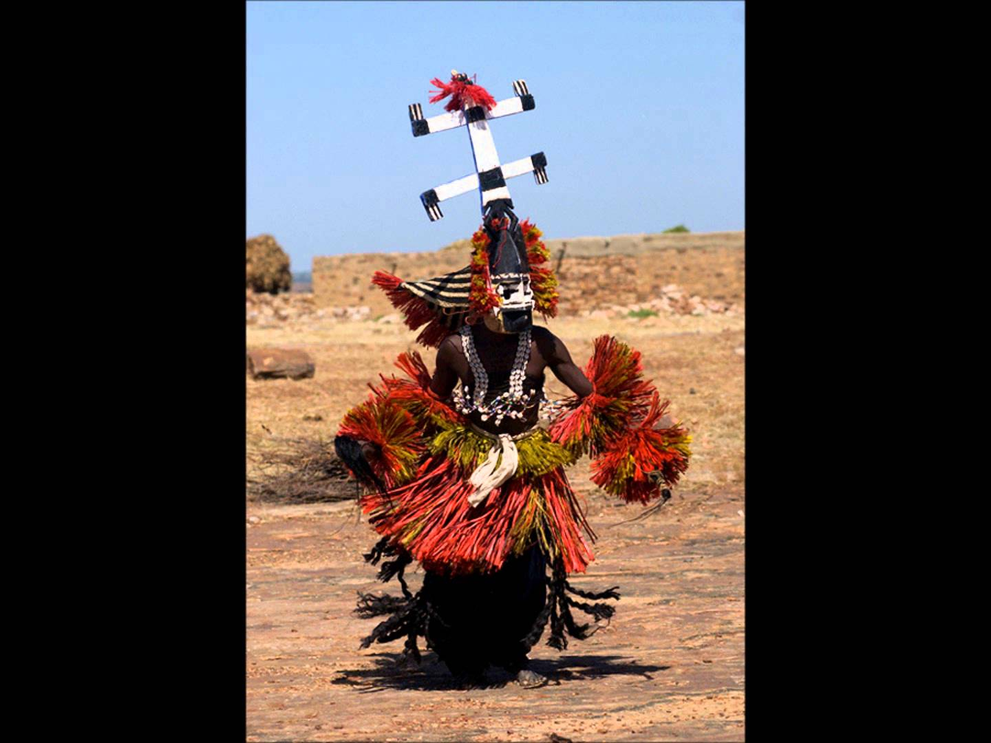
Elements of the ceremonial costume
The kanaga dancer also wears a pair of trousers made of indigo-dyed, strip-woven cotton cloth, over which he ties a long skirt of curly, loosely strung, black-dyed sanseveria fibers and short overskirts of straight red and yellow fibers.
For a traditional dama (or funeral ceremony), the preparation and dyeing of the fibers are undertaken with as much secrecy and ritual as is the carving of the wooden mask.

Slide 30
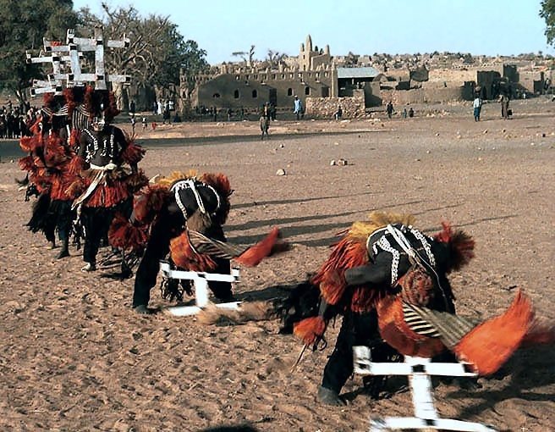
The kanaga masks dance during the dama ceremony
The Dogon believe that the Dama dance creates a bridge into the supernatural world.
When a dancer wears the Kanaga mask he symbolically becomes part of the Creator.
He touches the ground with his mask and directs a soul to Heaven.
Although these dances are now frequently performed for the public, the meaning of Kanaga is retained by the Dogon who fear, respect and depend on the power of the mask.
The belief is that without the Dama dance, the dead cannot cross over into peace.

Slide 31
View the video of the dance
West African Masks 9:18 mins
Dogon culture
https://www.youtube.com/watch?v=QgemQT6Lnqo

Slide 32
Sources on Senufo masks
P. Jan Vandenhoute, G.W. Harley, Poro and Mask : A Few Comments on Masks as agents of social control in Northeast Liberia (Ghent, 1989, Working Papers in Ethnic Art, 4)
Exhibition notes, Final Remaining Kpellie Mask from Our Parcours des Mondes (Paris) Exhibition - Berz Gallery of African ARt
http://berzgallery.com/simian-style-the-final-remaining-kpellie
---
IMAGES/Cleveland Museum of Art/Mask of the Senufo
http://www.clevelandart.org/art/1989.48?collection_search_views_fulltext=&collection_search_views_artist_full_name=&field_images_field_large_image_url=All&field_highlight_museum=All&f[0]=field_collection%3A823
see this page for other examples from The Cleveland Museum of Art
http://www.clevelandart.org/art/departments/african-art

Slide 33
Important Sources on Senufo masks
Cole, Herbert M. 2001. “The Senufo, Masks and Masquerades” and “Places of Assembly and Celebration” from A History of Art in Africa, by Monica Blackmun Visona, Robin Poynor, Herbert M. cole, and Michael D. Harris, eds. Pp. 149-152, and 152-153. New York: Harry N. Abrams, Inc. Publishers.
Forster, Till, Senufo masking and the art of Poro.., Vol. 26, African Arts, 01-01-1993, pp 30. Or see [http://liberia.flemister.info/poro.html]
Gagliardi, Susan. 2015. Senufo Unbound. Yale University Press.
Gagliardi, Susan Elizabeth. 2010. “Senufo Arts and Poro Initiation in Northern Côte d’Ivoire.” Essay for The Metropolitan Museum of Art.
https://www.metmuseum.org/toah/hd/poro/hd_poro.htm
Accessed: 1 Feb 2018.
Glaze, Anita J. 1981. Art and Death in a Senufo Village. Bloomington.
Meyer, Laure. 2001. “Masks for Important Occasions” in African Forms: Art and Rituals. New York, NY: Assouline. Pp. 150-151.
Richter, Dolores. 1979. “Senufo Mask Classification," African Arts 12, 3: 66-73, 93-94.

Slide 34
Video sources- Senufo
LA DANSE DES MASQUES DES FORGERONS DE KOFFRE COTE D'IVOIRE
Senufo masks dance 9:59 mins
https://www.youtube.com/watch?v=2KvgjC73J5k
Published on Oct 30, 2013.au cours des funerailles uniquemen c mamadou
------------------------------------------------------------------------------------
The Bridge of spirits - Part 4 The Senufo - 10:04 mins
New Atlantis Full Documentaries
https://www.youtube.com/watch?v=Rljf3boywZE&list=PL_w57E3bEZdfaBxxmuccYj-JP3S_sMZ8s&index=54
Published on Apr 26, 2013

Slide 35
video
What is Senufo ?/Published on Feb 3, 2015
https://www.youtube.com/watch?v=hYfh3odMMmU
exhibition, Senufo: Art and Identity in West Africa at the Cleveland Museum of Art.2015, explore the first exhibition devoted to the Senufo in more than 50 years, and download the app to learn more! Visit http://clevelandart.org/senufo for details.
Senufo: Art and Identity in West Africa at the Cleveland Museum of Art (Trailer)
Published on Mar 6, 2015
https://www.youtube.com/watch?v=rUv95dlHiQk

Slide 36
video resources on the Dogon
“African Carving: A Dogon Kanaga Mask” from Documentary Educational Resources
http://www.der.org/films/african-carving.html
West African Masks Dogon culture - 9:18 mins
https://www.youtube.com/watch?v=QgemQT6Lnqo
African Tribe MASKED DANCERS
https://www.youtube.com/watch?v=5pXRYQF6Bo0
African Art Techniques: Wood, Cloth, Metal, Clay 1:30 mins / watch the first 19:00 mins of the video, you can advance the video at times to see the whole process of making a mask.
https://www.youtube.com/watch?v=glnhCrHqHsY
Video by Jacob Bamogo, Abdoulaye Bamogo, Yacouba Bonde, and Christopher D. Roy. Produced, edited, and narrated by Christopher D. Roy. Copyright 2009 by Christopher D. Roy.
Category Education License Standard YouTube License
Published on Jan 24, 2014 / downloaded Feb. 8, 2016

Slide 37
Sources on the Dogon and/or Kanaga masks
Clarke, Christa. 2006. Dogon Masks. pp. 42, 49-51. from The Art of Africa: A Resource for Educators. THE METROPOLITAN MUSEUM OF ART. Downloaded Feb. 14, 2016.
http://www.metmuseum.org/~/media/Files/Learn/For%20Educators/Publications%20for%20Educators/The%20Art%20of%20Africa.pdf
Visona, Monica Blackmun, Robin Poynor, Herbert M. Cole, and Michael D. eds. 2001. A History of Art in Africa. New York: Harry N. Abrams, Inc., Publishers. See pages: 140-144.

